Slide 1

AI PLATFORM
COMPARISON
🤗 Hugging Face
◎ OpenAI API
Hugging Face Transformers vs OpenAI API
Background • Key features • Comparison • Best use cases
ITAI Deep Learning | Houston Community College | September 2026
Names : Emmanuel ABABIO, Robert Thompson, Olis Bahari
1

Slide 2
The big question
Both tools are powerful, but they solve different problems.
Do I need more control,
or do I need faster production results?
CONTROL
SPEED
This presentation compares the two platforms using four lenses:
The right answer depends on what your project values more.
Origin
Features
Usability
Scalability
Names : Emmanuel ABABIO, Robert Thompson, Olis Bahari
2

Slide 3
Background: where each tool came from
Hugging Face grew from open-source model sharing; OpenAI grew from frontier models delivered through products and APIs.
Hugging Face
founded
OpenAI API
beta / HF grows
2015
2016
2017
2020
Today
OpenAI
founded
Transformer
paper
Millions of models
+ managed AI APIs
Hugging Face Transformers
OpenAI API
An open-source Python library and model ecosystem for loading, training, sharing, and deploying pretrained models.
A hosted model platform that lets developers call advanced language, vision, audio, and tool-using models through APIs.
Names : Emmanuel ABABIO, Robert Thompson, Olis Bahari
3

Slide 4
Hugging Face Transformers: the open model path
Best when the project needs access to model weights, local control, or custom fine-tuning.
Hub
Load
Fine-tune
Evaluate
Deploy
models
datasets
Spaces
pipeline()
AutoModel
Tokenizer
Trainer
PEFT / LoRA
Accelerate
metrics
experiments
benchmarks
local
cloud
endpoint
Pretrained models reduce the need to train from zero.
Trainer, PEFT, and Accelerate support serious customization.
The Pipeline API makes common tasks easier to run.
You control the deployment: laptop, server, cloud, or hosted service.
Names : Emmanuel ABABIO, Robert Thompson, Olis Bahari
4

Slide 5
OpenAI API: the managed model path
Best when the project needs strong performance quickly without managing model infrastructure.
App
website
chatbot
workflow
Responses API
prompt
messages
tools
OpenAI models
reasoning
vision
audio
Output
answer
JSON
action
Built-in tools can extend the model
The tradeoff: you get operational simplicity, but you do not host or directly modify the main model weights.
Web search
File search
Code execution
Structured output
Names : Emmanuel ABABIO, Robert Thompson, Olis Bahari
5

Slide 6
Key features side-by-side
The difference is mostly open customization versus managed capability.
🤗 Hugging Face
◎ OpenAI API
Open-source ecosystem
Hosted frontier models
Access to many model families
Simple API integration
Local fine-tuning and PEFT
Built-in tools and structured outputs
Deploy locally, on-prem, edge, or cloud
Text, image, audio, and agent workflows
Compute cost depends on your hardware
Pay-per-token usage pricing
Names : Emmanuel ABABIO, Robert Thompson, Olis Bahari
6

Slide 7
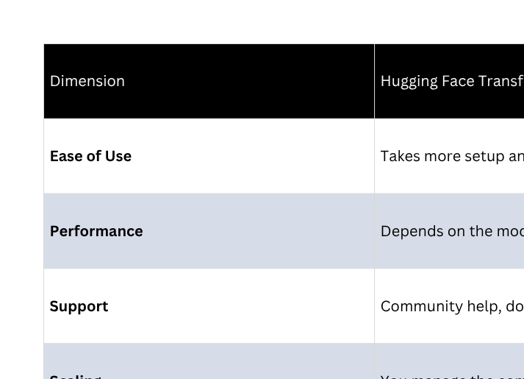
Comparative perspective
A clean way to choose is to compare what the project needs most.
Names : Emmanuel ABABIO, Robert Thompson, Olis Bahari
7

Slide 8
Which should you choose?
Choose based on the constraint that matters most.
Choose Hugging Face when…
Choose OpenAI when…
You need model-weight access
You need the fastest path to a good app
Privacy or offline use matters
Managed scaling is valuable
You want to test many model families
API access is easier than hosting
Your team can manage compute
Multimodal or agentic workflows matter
Many real projects use both: open models for control + hosted models for hardest tasks.
Names : Emmanuel ABABIO, Robert Thompson, Olis Bahari
8

Slide 9
Real-world application examples
Both platforms are used in production, but often for different reasons.
Prophia
Hugging Face: Extracting named entities from commercial real-estate documents.
BLOOM Project
Hugging Face : Large open-science language model collaboration on the Hub.
Intercom
OpenAI API: AI support workflows using low-latency conversational models.
Financial reporting teams
OpenAI API: Summarizing, analyzing, and drafting market/report content.
Names : Emmanuel ABABIO, Robert Thompson, Olis Bahari
9

Slide 10
Final takeaway
The strongest answer is not “A beats B.” It is choosing the right tool for the job.
Hugging Face = control, transparency, experimentation.
OpenAI API = speed, managed infrastructure, strong ready-to-use models.
Conclusion
For learning, research, and custom deployments, I would start with Hugging Face. For a polished application that needs strong results quickly, I would start with OpenAI. In many serious projects, using both is the smartest move.
Names : Emmanuel ABABIO, Robert Thompson, Olis Bahari
10

Slide 11
References
Credible sources used for this presentation.
Hugging Face. Transformers documentation. https://huggingface.co/docs/transformers/
Hugging Face. Hub documentation. https://huggingface.co/docs/hub/en/index
Hugging Face. PEFT and Trainer documentation. https://huggingface.co/docs/transformers/
OpenAI. OpenAI API documentation. https://platform.openai.com/docs/
OpenAI. About OpenAI. https://openai.com/about/
OpenAI. GPT-4 / GPT-4o research and product posts. https://openai.com/index/
Vaswani et al. (2017). Attention Is All You Need. NeurIPS.
Presentation structure adapted from the two provided model decks.
Names : Emmanuel ABABIO, Robert Thompson, Olis Bahari
11

Slide 12
Thank you For your Time
4

